Slide 1
CMS Data Ingestion, Transformation and Storage Solution Architecture
Jayaprakash S

Slide 2
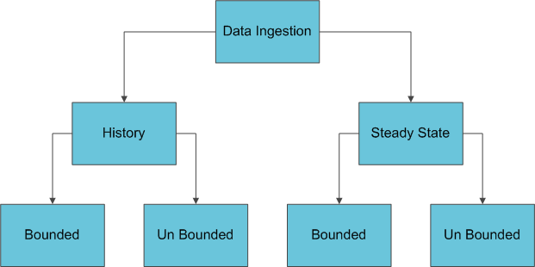
Solution Architecture – Data Ingestion Considerations - 1

Slide 3
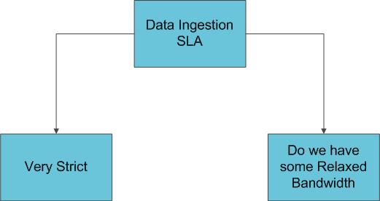
Solution Architecture – Data Ingestion Considerations -2

Slide 4
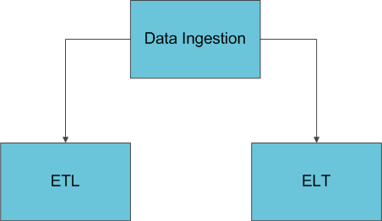
Solution Architecture – Data Ingestion Considerations - 3

Slide 5
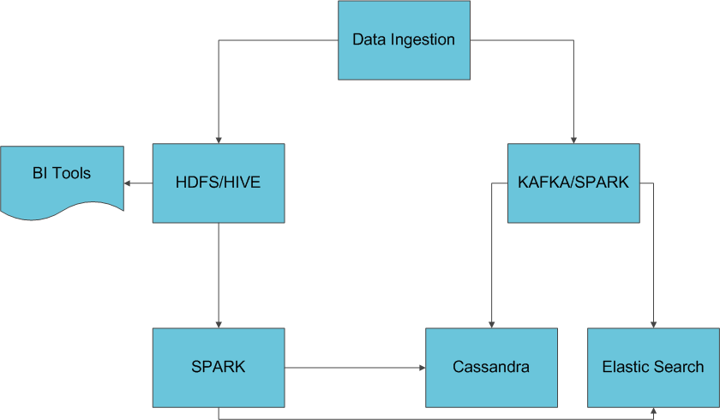
Solution Architecture – Data Ingestion Considerations - 4

Slide 6
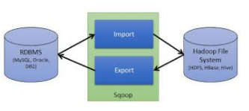
Deep Dive
History and Steady State Bounded – Option 1:
The caveat is SQOOP submits a IO Intensive Map Reduce JOB

Slide 7
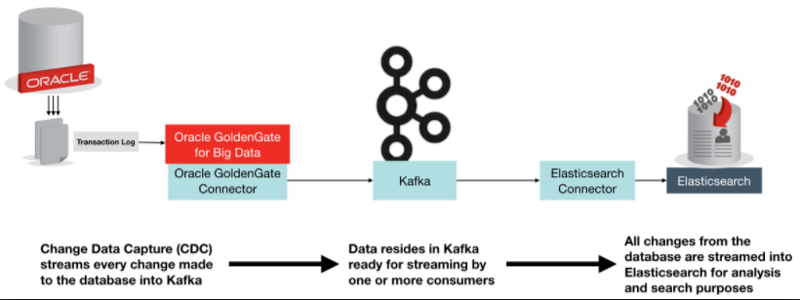
Deep Dive
History and Steady State Bounded – Option 2:
Still working on POC
Option in plate for performance at the expense of costly memory intensive utilization

Slide 8

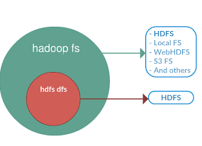

Deep Dive
History and Steady State Bounded – Option 3:
For Bounded Files / Tables Options
Apache NIFI -> HDFS PUT Script -> HDFS Load
Python framework to poll the files and push to target HDFS / HIVE location but still TCS MasterCraft tool is a very good option
Straight forward – Can integrate with Spark if transformation required before load

Slide 9
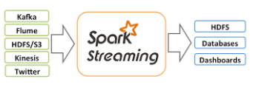
Deep Dive
History and Steady State Un Bounded – Option 4:
NIFI CDC is very good option to push the message to KAFKA Topic
Python framework to connect to external API and push the message to KAFKA Topic
Use Spark Streaming as consumer or Flume as consumer depends on the requirement transformation / aggregation

Slide 10
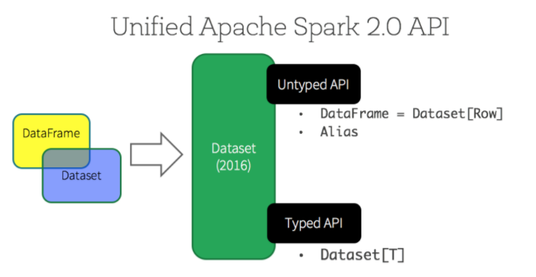
Deep Dive
Spark 2.0 – Unified Programming Model for Bounded and Unbounded Data Sources

Slide 11
Deep Dive
Spark Kafka Connector
https://spark.apache.org/docs/2.2.0/streaming-kafka-integration.html

Slide 12
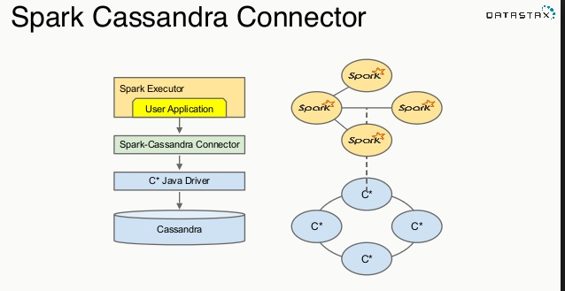
Deep Dive

Slide 13
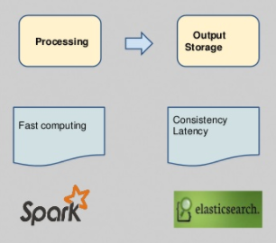
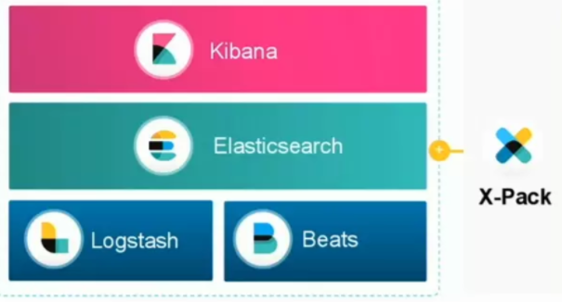
Deep Dive
Spark ElasticSearch Connector:
https://www.elastic.co/guide/en/elasticsearch/hadoop/master/spark.html

Slide 14
Downside of Cassandra
Background JVM makes performance unpredictable
Garbage Collection Tuning
Tradeoff Between Consistency and Performance
Data Replication will be more because the Data Model is based on Specific Use Cases
Costly as it is memory intensive
Non ACID Compliant

Slide 15


